Slide 1
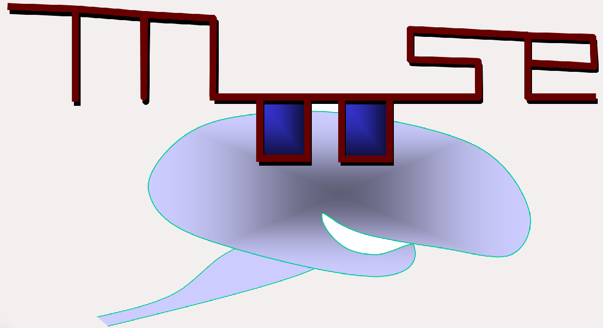
MOOSE: Multi-scale Object Oriented Simulation Environment
Aditya Gilra
CAMP 2016

Slide 2
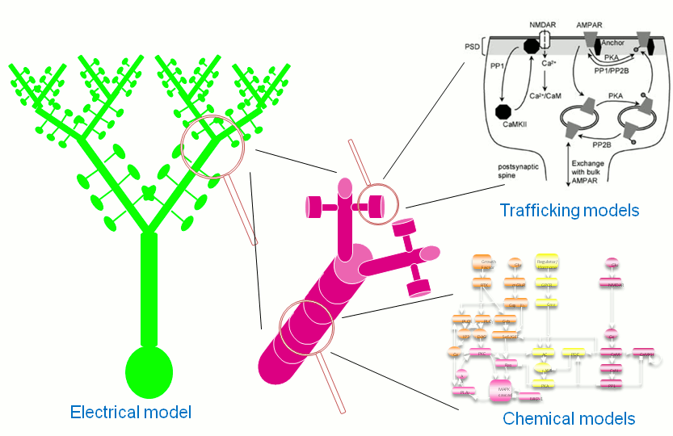
MOOSE?
Multi-scale
Object-oriented: classes connected by messages
Simulation Environment: solvers, python scripting, GUI, multiple input/output formats

Slide 3
helloMoose.py
loadModel()
  Genesis, SBML, NeuroML
wildcardFind()
  Model structure is like nested folders
  ## for full depth, # for 1 level down
ipython -i helloMoose.py
  help(moose), help(moose.Compartment), dir(moose)
  moose.le('/')
  moose.element(), elem.className

Slide 4
Inject current in a passive compartment
Make Compartment, with a PulseGen input
Make recording table
Connect pulse-gen to compartment
Connect compartment Vm to table
Plot Vm from the table

Slide 5
Digging up more
/usr/lib/moose/moose-examples/snippets
Genesis documentation helps in moose too: http://www.genesis-sim.org/
All objects are vectors
moose.connect(obj1,srcFinfo,obj2,destFinfo, ['Single,'OneToOne','OneToAll','Sparse',...])
moose.getFieldNames('SimpleSynHandler' [,'srcFinfo'|,'destFinfo'|,'valueFinfo'])

Slide 6
Active compartment
neuroml/GranuleCell/Granule98.py
Load NeuroML model (level 1,2,3)
moose.utils for setupTable(), resetSim()
  /usr/lib/python2.7/dist-packages/moose/utils.py
NeuroML
  neuroml.org
  neuroConstruct.org
Try also:
  FvsI_Granule98.py
  neuroml/allChannelsCell/allChannelsCell.py

Slide 7
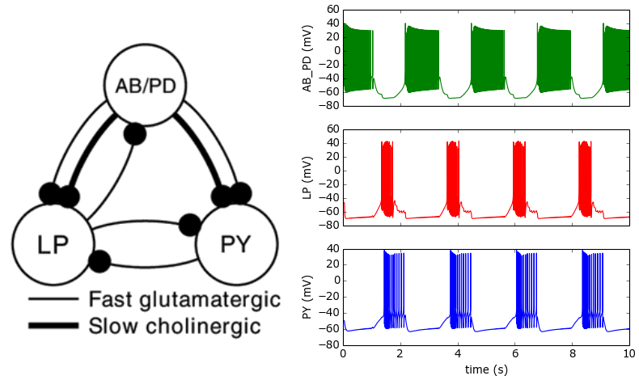
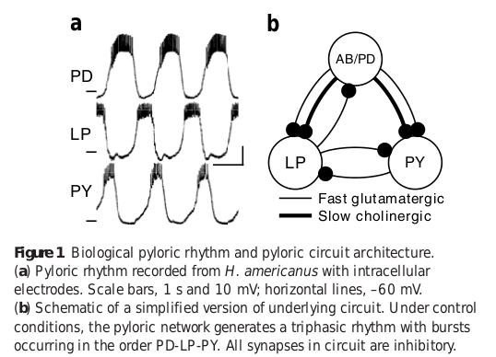
Lobster STG pattern generator
Lobster stomatogastric ganglion
neuroml/lobster_pyloric

